Slide 1
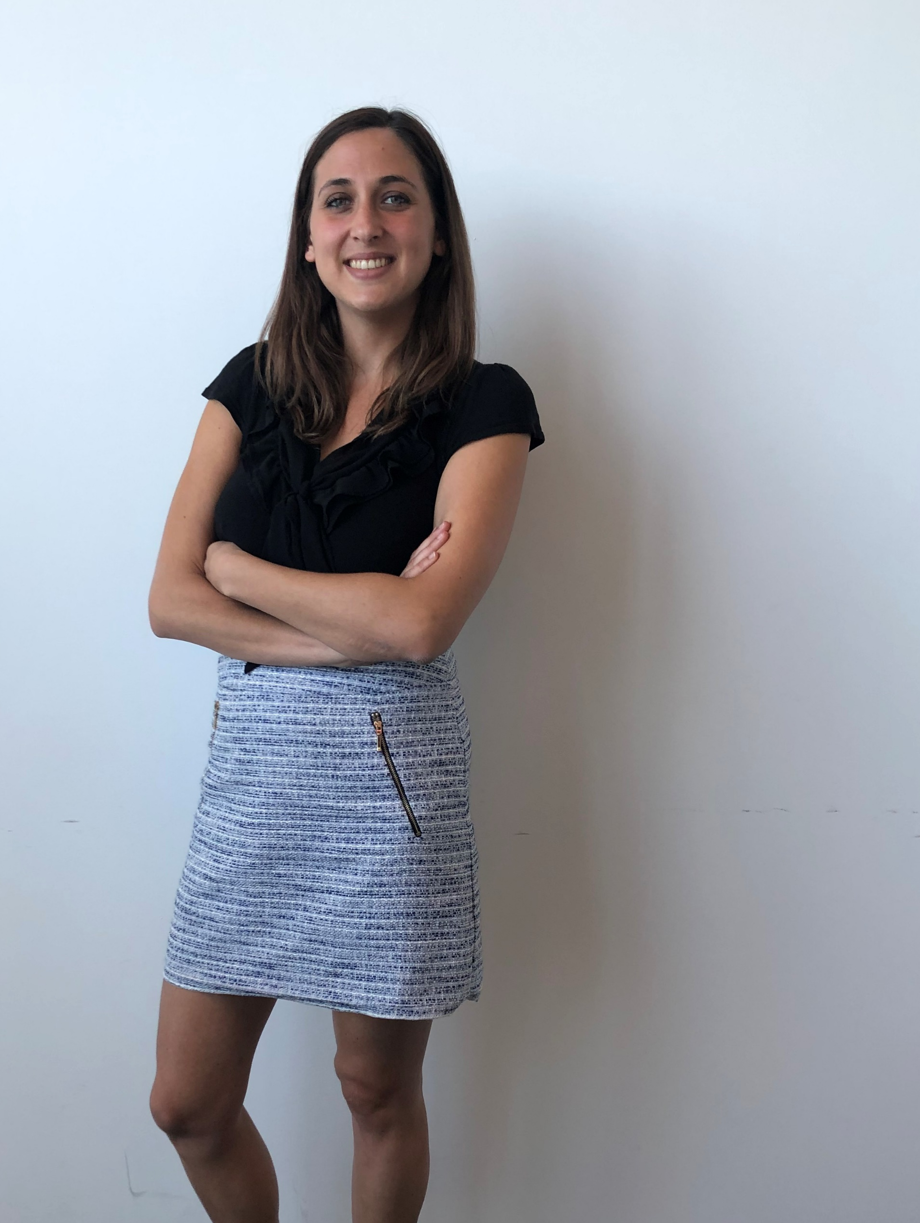
WELCOME to
Noémie!
Noémie Garrigue
Recruiteur
#Team Belval

